Slide 1

Machine Learning

Slide 2
QUANTITATIVE DATA:
Data that can be expressed as a number or can be quantified. In other words, quantitative data can be measured by numerical variables.
Key characteristics :
It can be quantified and verified.
Data can be counted.
Data type: number and statistics.
It answers questions such as “how many, “how much” and “how often”.
Example:
Scores on tests and exams e.g. 85, 67, 90 and etc.
The weight of a person or a subject.
The temperature in a room.

Slide 3
Types of quantitative data:
Discrete data :
A count that involves integers. Only a limited number of values is possible. The discrete values cannot be subdivided into parts. For example, the number of children in a school is discrete data. You can count whole individuals. You can’t count 1.5 kids.
Continuous data :
Information that could be meaningfully divided into finer levels. It can be measured on a scale or continuous sequence and can have almost any numeric value. For example, you can measure your height at very precise scales — meters, centimeters, millimeters and etc

Slide 4
QUALITATIVE DATA:
Also called categorical data. The reason is that the information can be sorted by category, not by number. Is analyzed to look for common themes.
Key characteristics
It cannot be quantified and verified.
Data cannot be counted.
Data type: words, objects, pictures, observations, and symbols.
It answers questions such as “how this has happened” or and “why this has happened”.

Slide 5
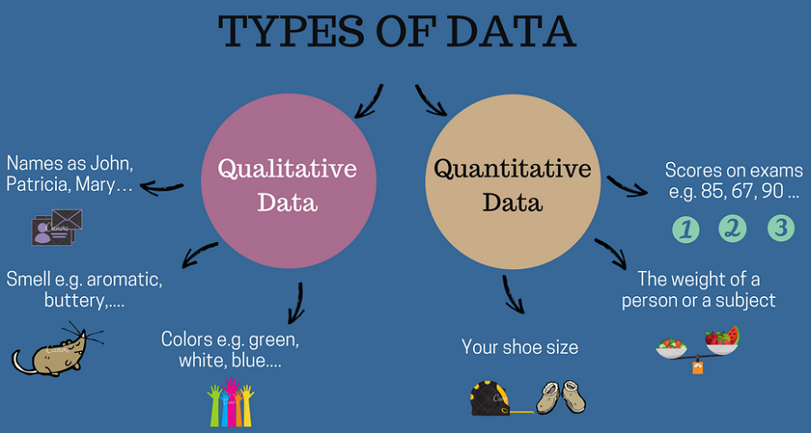

Slide 6
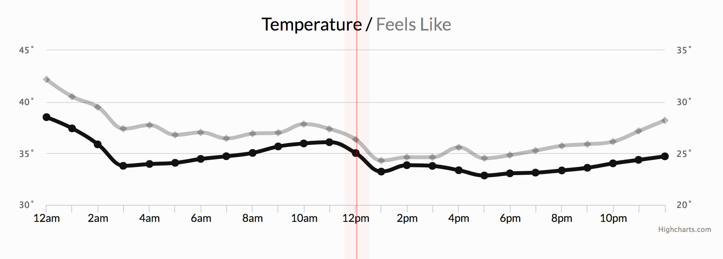
Time-series Data
Time-series data refers to a set of observations taken over a given period of time at specific and equally-spaced time intervals. That the observations are taken at specific points in time means time intervals are discrete.
In other words, A set of observations contains values, taken by variable at different times.
Examples :
Consumption of energy per hour
Sales on daily basis
Company's profits per quarter
Weather records.

Slide 7
Big Data includes huge volume, high velocity, and extensible variety of data.
Structured data :
The data whose elements are addressable for effective analysis. It has been organized into a formatted file that is typically a database.
Semi-Structured data :
Semi-structured data is information that does not reside in a relational database but that have some organizational properties that make it easier to analyze.
Unstructured data :
Unstructured data is a data which is not organized in a predefined manner or does not have a predefined data model, thus it is not a good fit for a mainstream relational database.

Slide 8
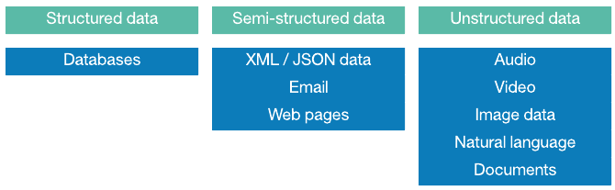

Slide 9
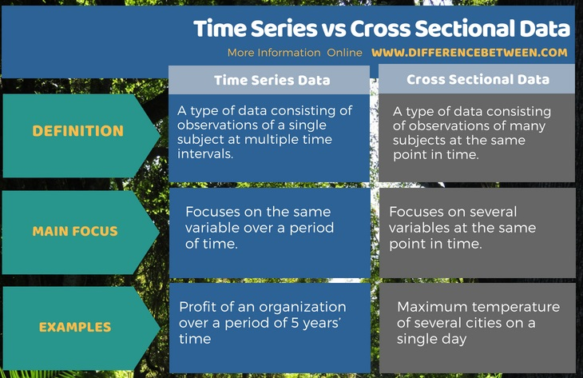
Difference between Cross sectional data & Time series data.

Slide 10
Thank You

